Slide 1
Microsoft Azure AI Fundamentals: AI Overview
Notes:
This content is meant to be taught as a companion to: Microsoft Azure AI Fundamentals: AI Overview - Training | Microsoft Learn.

Slide 2
Agenda
Fundamental AI concepts
Fundamentals of machine learning
Fundamentals of Azure AI services
Notes:
Time estimates:
- Fundamental AI concepts: 15 minutes
- Fundamentals of machine learning: 30 minutes
- Fundamentals of Azure AI services: 15 minutes
- The exercise should take an additional 20 minutes.

Slide 3
Learning Objectives
After completing this module, you will be able to:
1
Explain what AI is and understand the importance of responsible AI.
2
Understand the different types machine learning models.
3
Identify the AI services available on Azure, and what they are used for.

Slide 4
Fundamental AI concepts
Notes:
The goal of this topic is to introduce some fundamental, high-level concepts; which we'll explore in greater depth later in the course. Don’t spend too much time getting into the details here.

Slide 5
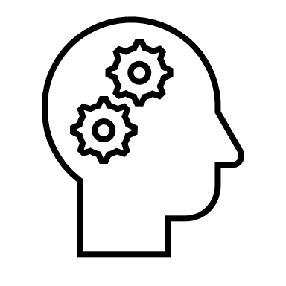
What is Artificial Intelligence?
Software that imitates human capabilities
Predicting outcomes and recognizing patterns based on historic data.
Recognizing abnormal events and making decisions.
Interpreting visual input.
Understanding language and engaging in conversations.
Extracting information from sources to gain knowledge.
Notes:
These are all things that most humans do on a day-to-day basis, often subconsciously:
We make predictions or recognize patterns using the information we have available and our past experience to guide us.
We can intuitively know when something isn’t quite right or doesn't fit an expected pattern.
We use sight to experience the world visually.
We communicate by writing and speaking, and engage in dynamic conversations, responding appropriately.
We can extract information from multiple sources to extend our knowledge

Slide 6










Common AI workloads
 | Machine Learning | Predictive models based on data and statistics – the foundation for AI.
 | Computer Vision | Capabilities within AI to interpret the world visually through cameras, video, and images.
 | Natural Language Processing | Capabilities within AI for a computer to interpret written or spoken language and respond appropriately.
 | Document Intelligence | Capabilities within AI that deal with managing, processing, and using high volumes of data found in forms and documents.
 | Knowledge Mining | Capabilities within AI to extract information from large volumes of often unstructured data to create a searchable knowledge store.
 | Generative AI | Capabilities within AI that create original content in a variety of formats including natural language, image, code, and more.
Notes:
The slide lists common workloads or "areas" of AI, which correspond to the human traits on the previous slide.
We'll explore each of these workloads in detail, but for now just point out that in many solutions, the workloads may overlap.
For example, imagine a conversational AI solution that uses a bot to process an auto insurance claim. The bot relies on some natural language processing capabilities to make sense of input such as "I want to submit a claim". It may allow users to send a photograph of a damaged vehicle, use computer vision to assess the damage, and apply a machine learning model to predict likely repair costs. The bot might also use anomaly detection to identify potentially fraudulent claims. Finally, the claims data, including forms, photographs, and other artefacts might be indexed to extract insights and create a searchable knowledge store to help manage future claims.

Slide 7






Principles of responsible AI
 | Challenge or Risk | Example
Fairness | Bias can affect results. | A loan-approval model discriminates by gender due to bias in the data with which it was trained.
Reliability & safety | Errors may cause harm. | An autonomous vehicle experiences a system failure and causes a collision.
Privacy & security | Private data could be exposed. | A medical diagnostic bot is trained using sensitive patient data, which is stored insecurely.
Inclusiveness | Solutions may not work for everyone. | A predictive app provides no audio output for visually impaired users.
Transparency | Users must trust a complex system. | An AI-based financial tool makes investment recommendations – what are they based on?
Accountability | Who’s liable for AI-driven decisions? | An innocent person is convicted of a crime based on evidence from facial recognition – who’s responsible?
Notes:
At Microsoft, AI software development is guided by a set of six principles for responsible AI.
Use the summaries below to relate these to the challenges and risks on the previous slide.
Fairness AI systems should treat all people fairly. For example, suppose you create a machine learning model to support a loan approval application for a bank. The model should make predictions of whether the loan should be approved without incorporating any bias based on gender, ethnicity, or other factors that might result in an unfair advantage or disadvantage to specific groups of applicants.
Azure Machine Learning includes the capability to interpret models and quantify the extent to which each feature of the data influences the model's prediction. This capability helps data scientists and developers identify and mitigate bias in the model.
Reliability and safety AI systems should perform reliably and safely. For example, consider an AI-based software system for an autonomous vehicle; or a machine learning model that diagnoses patient symptoms and recommends prescriptions. Unreliability in these kinds of system can result in substantial risk to human life.
AI-based software application development must be subjected to rigorous testing and deployment management processes to ensure that they work as expected before release.
Privacy and security AI systems should be secure and respect privacy. The machine learning models on which AI systems are based rely on large volumes of data, which may contain personal details that must be kept private. Even after the models are trained and the system is in production, it uses new data to make predictions or take action that may be subject to privacy or security concerns.
Inclusiveness AI systems should empower everyone and engage people. AI should bring benefits to all parts of society, regardless of physical ability, gender, sexual orientation, ethnicity, or other factors.
Transparency AI systems should be understandable. Users should be made fully aware of the purpose of the system, how it works, and what limitations may be expected.
Accountability People should be accountable for AI systems. Designers and developers of AI-based solution should work within a framework of governance and organizational principles that ensure the solution meets ethical and legal standards that are clearly defined.

Slide 8
Fundamentals of machine learning
Notes:
The goal of this topic is to introduce some fundamental, high-level concepts. Students do not need to memorize the mechanics of deep learning or know the algorithms used for different types of machine learning. The focus is to show how machine learning models can support inferencing tasks. That way, in the third section on Azure AI services, students can connect the building blocks of machine learning with AI services.

Slide 9



What is machine learning?
Creating predictive models by finding relationships in data
1. Training data
(past observations)
2. Algorithm
(Generalizes the relationship between x and y as a function)
3. Model
(encapsulates the function)
[x₁,x₂,x₃], y
[x₁,x₂,x₃], y
[x₁,x₂,x₃], y
[x₁,x₂,x₃], y
[x₁,x₂,x₃], y
Training
y = f(x)
Features
(x)
Label
(y)
[x₁,x₂,x₃]
ŷ
Inferencing
4. Inferencing data
(unlabeled features)
Prediction
(inferred label)
Notes:
The training data consists of past observations. In most cases, the observations include the observed attributes or features of the thing being observed, and the known value of the thing you want to train a model to predict (known as the label). In mathematical terms, you'll often see the features referred to using the shorthand variable name x, and the label referred to as y. Usually, an observation consists of multiple feature values, so x is actually a vector (an array with multiple values), like this: [x₁,x₂,x₃,...].
An algorithm is applied to the data to try to determine a relationship between the features and the label, and generalize that relationship as a calculation that can be performed on x to calculate y. The specific algorithm used depends on the kind of predictive problem you're trying to solve (more about this later), but the basic principle is to try to fit the data to a function in which the values of the features can be used to calculate the label.
The result of the algorithm is a model that encapsulates the calculation derived by the algorithm as a function - let's call it f. In mathematical notation: y = f(x)
Now that the training phase is complete, the trained model can be used for inferencing. The model is essentially a software program that encapsulates the function produced by the training process. You can input a set of feature values, and receive as an output a prediction of the corresponding label. Because the output from the model is a prediction that was calculated by the function, and not an observed value, you'll often see the output from the function shown as ŷ (which is rather delightfully verbalized as "y-hat").

Slide 10




















Types of machine learning
Machine Learning
Supervised machine learning
Training data includes known labels
Unsupervised machine learning
Training data is unlabeled
Regression
Label is a numeric value
Classification
Label is a categorization (or class)
Clustering
Similar items are grouped together
Binary classification
Label is or is not a class
Multiclass classification
Label is one of multiple classes
5
Predict the number of ice creams sold based on day, season, and weather
Separate plants into groups based on common characteristics
Predict whether a patient is at-risk for diabetes based on clinical data
Predict the species of a penguin based on its measurements
Notes:
Supervised machine learning
Supervised machine learning is a general term for machine learning algorithms in which the training data includes both feature values and known label values. Supervised machine learning is used to train models by determining a relationship between the features and labels in past observations, so that unknown labels can be predicted for features in future cases.
Regression
Regression is a form of supervised machine learning in which the label predicted by the model is a numeric value. For example:
The number of ice creams sold on a given day, based on the temperature, rainfall, and windspeed.
The selling price of a property based on its size in square feet, the number of bedrooms it contains, and socio-economic metrics for its location.
The fuel efficiency (in miles-per-gallon) of a car based on its engine size, weight, width, height, and length.
Classification
Classification is a form of supervised machine learning in which the label represents a categorization, or class. There are two common classification scenarios.
Binary classification
In binary classification, the label determines whether the observed item is (or isn't) an instance of a specific class. Or put another way, binary classification models predict one of two mutually exclusive outcomes. For example:
Whether a patient is at risk for diabetes based on clinical metrics like weight, age, blood glucose level, and so on.
Whether a bank customer will default on a loan based on income, credit history, age, and other factors.
Whether a mailing list customer will respond positively to a marketing offer based on demographic attributes and past purchases.
In all of these examples, the model predicts a binary true/false or positive/negative prediction for a single possible class.
Multiclass classification
Multiclass classification extends binary classification to predict a label that represents one of multiple possible classes. For example,
The species of a penguin (Adelie, Gentoo, or Chinstrap) based on its physical measurements.
The genre of a movie (comedy, horror, romance, adventure, or science fiction) based on its cast, director, and budget.
In most scenarios that involve a known set of multiple classes, multiclass classification is used to predict mutually exclusive labels. For example, a penguin can't be both a Gentoo and an Adelie. However, there are also some algorithms that you can use to train multilabel classification models, in which there may be more than one valid label for a single observation. For example, a movie could potentially be categorized as both science fiction and comedy.
Unsupervised machine learning
Unsupervised machine learning involves training models using data that consists only of feature values without any known labels. Unsupervised machine learning algorithms determine relationships between the features of the observations in the training data.
Clustering
The most common form of unsupervised machine learning is clustering. A clustering algorithm identifies similarities between observations based on their features, and groups them into discrete clusters. For example:
Group similar flowers based on their size, number of leaves, and number of petals.
Identify groups of similar customers based on demographic attributes and purchasing behavior.
In some ways, clustering is similar to multiclass classification; in that it categorizes observations into discrete groups. The difference is that when using classification, you already know the classes to which the observations in the training data belong; so the algorithm works by determining the relationship between the features and the known classification label. In clustering, there's no previously known cluster label and the algorithm groups the data observations based purely on similarity of features.
In some cases, clustering is used to determine the set of classes that exist before training a classification model. For example, you might use clustering to segment your customers into groups, and then analyze those groups to identify and categorize different classes of customer (high value - low volume, frequent small purchaser, and so on). You could then use your categorizations to label the observations in your clustering results and use the labeled data to train a classification model that predicts to which customer category a new customer might belong.
How this relates to x and y from the previous slide:
In the ice cream sales scenario, our goal is to train a model that can predict the number of ice cream sales based on the weather. The weather measurements for the day (temperature, rainfall, windspeed, and so on) would be the features (x), and the number of ice creams sold on each day would be the label (y).
In the medical scenario, the goal is to predict whether or not a patient is at risk of diabetes based on their clinical measurements. The patient's measurements (weight, blood glucose level, and so on) are the features (x), and the likelihood of diabetes (for example, 1 for at risk, 0 for not at risk) is the label (y).
In the Antarctic research scenario, we want to predict the species of a penguin based on its physical attributes. The key measurements of the penguin (length of its flippers, width of its bill, and so on) are the features (x), and the species (for example, 0 for Adelie, 1 for Gentoo, or 2 for Chinstrap) is the label (y).

Slide 11

Model training and evaluation
Multiple training iterations with different algorithms and parameters
1. Training data
(past observations)
2. Algorithm
(Generalizes the relationship between x and y as a function)
3. Model
(encapsulates the function)
[x₁,x₂,x₃], y
[x₁,x₂,x₃], y
[x₁,x₂,x₃], y
[x₁,x₂,x₃], y
[x₁,x₂,x₃], y
y = f(x)
5. Evaluate model (compare predicted labels to actual labels)
[x₁,x₂,x₃], y
[x₁,x₂,x₃], y
[x₁,x₂,x₃], y
4. Predictions
(from the validation data)
Validation data
(with known labels)
Notes:
Split the data into a training set and a validation set
Apply an algorithm to fit the training data to a model
The trained model encapsulates the relationships in the data
Use the model to generate predictions from the validation data
Use evaluation metrics to compare predicted vs actual labels (supervised) or measure cluster separation (unsupervised)
Repeat…
The learning component of machine learning occurs during training. We try to capture the relationships between the features and label in a model. Training is the action of iterating on an algorithm to best fit, or encapsulate those relationships.
After training, we have a model that we can test. We can use some of the data set aside, validation data, to test how closely our model's predicted labels are to actual labels. In the case of unsupervised learning where we don't know the actual labels, we measure how well our model's predicted labels were at separating clusters. There are many types of evaluation metrics. The important thing to remember is that the goal of machine learning is to find a model that gets as close as possible to predicting the actual label. The best model can still have some margin of error.

Slide 12
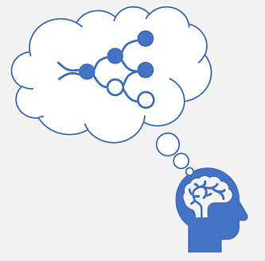
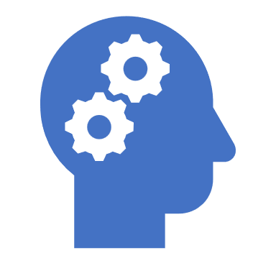
Deep learning
Human neural network
Artificial neural network
x
w
∫( )
f (x,w)
Neurons fire in response to electrochemical stimuli
When fired, the signal is passed to connected neurons
Each neuron is a function that operates on an input value (x) and a weight (w)
The function is wrapped in an activation function that determines whether to pass the output on
Notes:
Deep learning is an advanced form of machine learning that tries to emulate the way the human brain learns. The key to deep learning is the creation of an artificial neural network that simulates electrochemical activity in biological neurons by using mathematical functions.
Artificial neural networks are made up of multiple layers of neurons - essentially defining a deeply nested function. This architecture is the reason the technique is referred to as deep learning and the models produced by it are often referred to as deep neural networks (DNNs). You can use deep neural networks for many kinds of machine learning problem, including regression and classification, as well as more specialized models for natural language processing and computer vision.

Slide 13
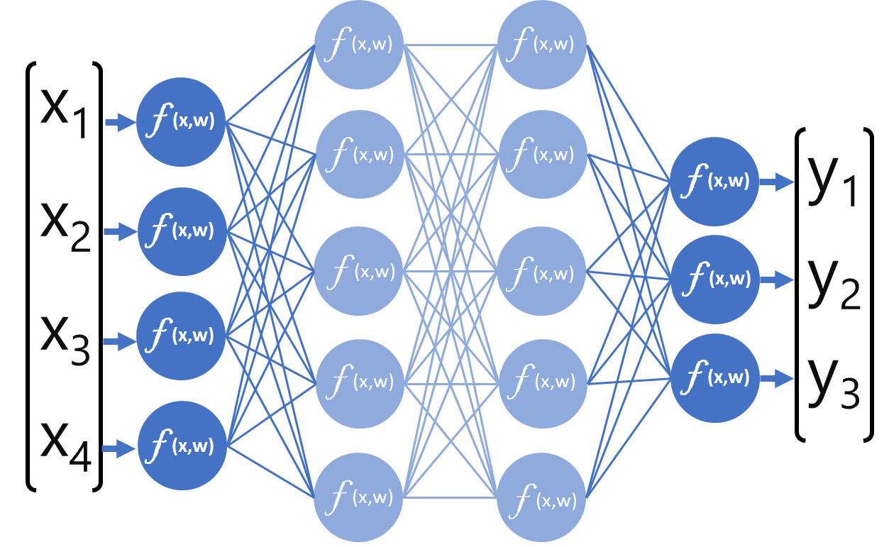



Deep learning Neural network example – multiclass classification
f (x,w)
f (x,w)
x₁
f (x,w)
f (x,w)
f (x,w)
0
f (x,w)
y₁
x₁: 37.3
x₂: 16.8
x₃: 19.2
x₄: 30.0
x₂
f (x,w)
f (x,w)
f (x,w)
y₂
P(y=0 | x): 0.2
P(y=1 | x): 0.7
P(y=2 | x): 0.1
1
f (x,w)
x₃
f (x,w)
f (x,w)
f (x,w)
f (x,w)
y₃
2
x₄
f (x,w)
f (x,w)
f (x,w)
Notes:
To better understand how a deep neural network model works, let's explore an example in which a neural network is used to define a classification model for penguin species.
The feature data (x) consists of some measurements of a penguin. Specifically, the measurements are:
The length of the penguin's bill.
The depth of the penguin's bill.
The length of the penguin's flippers.
The penguin's weight.
The label we're trying to predict (y) is the species of the penguin, and that there are three possible species it could be:
Adelie
Gentoo
Chinstrap
The process for inferencing a predicted penguin class using this network is:
The feature vector for a penguin observation is fed into the input layer of the neural network, which consists of a neuron for each x value. In this example, the following x vector is used as the input: [37.3, 16.8, 19.2, 30.0]
The functions for the first layer of neurons each calculate a weighted sum by combining the x value and w weight. ***
Each neuron in a layer is connected to all of the neurons in the next layer. The results of each layer are fed forward through the network until they reach the output layer.
The output layer produces a vector of values; in this case, using a softmax or similar function to calculate the probability distribution for the three possible classes of penguin. In this example, the output vector is: [0.2, 0.7, 0.1]
The elements of the vector represent the probabilities for classes 0, 1, and 2. The second value is the highest, so the model predicts that the species of the penguin is 1 (Gentoo).
The model learns the appropriate weights by iteratively passing the training data through and evaluating the predicted probabilities for each class against the known class label. The weights are adjusted in each iteration to reduce the amount of error (loss) between the predicted probabilities (for example [0.2, 0.7, 0.1] and the values that represent the actual class label (for example [0.0, 1.0, 0.0] for class 1 (Gentoo)

Slide 14
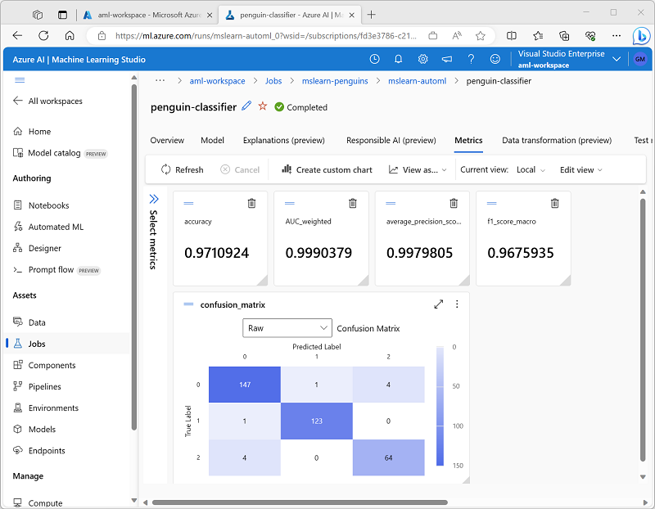
What is Azure Machine Learning?
Azure Machine Learning is a cloud-based platform for machine learning.
Azure Machine Learning Studio is a user interface for accessing Azure Machine Learning capabilities.
Machine learning models trained with Azure Machine Learning can be published as services.
Notes:
After talking to the slide for a minute or so, show students your Azure ML workspace in the Azure Portal, and then show them Azure ML Studio (ml.azure.com)
Microsoft Azure Machine Learning is a cloud service for training, deploying, and managing machine learning models. It's designed to be used by data scientists, software engineers, devops professionals, and others to manage the end-to-end lifecycle of machine learning projects, including:
Exploring data and preparing it for modeling.
Training and evaluating machine learning models.
Registering and managing trained models.
Deploying trained models for use by applications and services.
Reviewing and applying responsible AI principles and practices.
After you've provisioned an Azure Machine Learning workspace, you can use it in Azure Machine Learning studio; a browser-based portal for managing your machine learning resources and jobs.
In Azure Machine Learning studio, you can (among other things):
Import and explore data.
Create and use compute resources.
Run code in notebooks.
Use visual tools to create jobs and pipelines.
Use automated machine learning to train models.
View details of trained models, including evaluation metrics, responsible AI information, and training parameters.
Deploy trained models for on-request and batch inferencing.
Import and manage models from a comprehensive model catalog.

Slide 15

Demo: Explore Automated Machine Learning in Azure Machine Learning Studio
Follow along on the exercise page at: https://go.microsoft.com/fwlink/?linkid=2250144
In this demo, you will see how machine learning features can be used to train a machine learning model to make predictions.
Notes:
Instructors: we recommend you complete the exercise head of time: https://microsoftlearning.github.io/mslearn-ai-fundamentals/Instructions/Labs/01-machine-learning.html. This is recommended as a demo to save class time and to keep students focused on the concepts rather than implementation. Train the model ahead of time. During class, you can show students the “Test the deployed service” portion.

Slide 16
Fundamentals of Azure AI services
Notes:
The goal of this topic is to introduce some fundamental, high-level concepts; which we'll explore in greater depth later in the course. Don’t spend too much time getting into the details here.

Slide 17






Azure basics
Microsoft’s Azure cloud platform provides scalable and reliable:
Data storage
Compute
Services
Subscription
Resource Group
Resources
Notes:
Ask students about their existing level experience with Azure and cloud services in general, and if appropriate provide a quick demonstration of navigating the Azure portal at https://portal.azure.com.

Slide 18

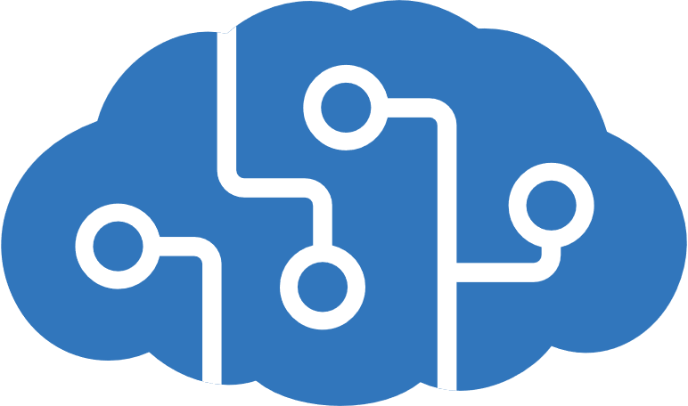

AI services in Microsoft Azure
Azure Machine Learning
A platform for training, deploying, and managing machine learning models
Azure AI services
A suite of services covering Vision, Speech, Language, Decision, and Generative AI
Azure AI Search
Data extraction, enrichment, and indexing for intelligent search and knowledge mining
Notes:
The Azure AI services we cover in this course focus on the areas of:
- Azure AI Vision, including the features Image Analysis, Face, and Optical Character Recognition
- Azure AI Language, including the information extraction, text summarization and classification, question answering, and conversational language understanding
- Azure AI Speech, including text to speech and speech to text
- Azure OpenAI
You’ll also get a chance to understand:
- Azure Cognitive Search
- Azure Machine Learning and how machine learning forms the foundation of AI’s predictive capabilities.

Slide 19




Azure AI services
AI application resources in an Azure subscription:
Standalone resources for specific services
General Azure AI services resource for multiple services
Consumed by applications via:
A REST endpoint (https://address)
An authentication key or authorization token
https://eastus/...
abc-1234-efg-5678…
Notes:
It's worth spending a little more time examining Azure AI services, as they illustrate a pattern that is common for many AI app scenarios on Azure.
To use Azure AI services, you must provision a resource in your Azure subscription. This can be a standalone, service-specific resource (for example, an AI Vision resource) or a general Azure AI services resource that encapsulates multiple services. Using a standalone service-specific resource enables you to manage costs and access to that service independently of other services you may be using, while a general Azure AI services resource enables you to combine all of your AI services in a single Azure resource for centralized management.
Regardless of the type of resource you use, client applications will consume the services it provides by connecting to a REST endpoint (an HTTPS address to which they can submit requests) using a resource-specific key for authentication.

Slide 20
Exercise: Explore Azure AI services
Use the hosted environment and Azure credentials provided for this exercise.
In this exercise, you will explore the Content Safety Studio, create a resource and try out an Azure AI service.
The instructions are also available on Learn: https://go.microsoft.com/fwlink/?linkid=2250253
Notes:
If necessary, demonstrate how to sign into Azure.
The important aspects of this exercise:
- Students get a sense of how services can be accessed after creating a resource
- Students understand where to locate the resource key and endpoint in the Azure portal
Students do not need to focus on specific capabilities of the Content Safety service

Slide 21
Knowledge check
1
You want to create a model to predict sales of ice cream based on historic data that includes daily ice cream sales totals and weather measurements. Which Azure service should you use?
Azure Machine Learning
Azure Bot Service
Azure AI services
2
An automobile dealership wants to use historic car sales data to train a machine learning model. The model should predict the price of a pre-owned car based on its make, model, engine size, and mileage. What kind of machine learning model should the dealership use automated machine learning to create?
Classification
Regression
Time series forecasting
3
A predictive app provides audio output for visually impaired users. Which principle of Responsible AI is reflected here?
Transparency
Inclusiveness
Fairness
Notes:
Allow students a few minutes to think about the questions, and then reveal the correct answers.

Slide 22

Summary
Fundamental AI concepts
What is AI?
Common AI workloads
Principles of responsible AI
Fundamentals of Machine Learning
What is machine learning?
Types of machine learning
Model training and validation
What is Deep Learning?
What is Azure Machine Learning?
Fundamentals of Azure AI services
Azure basics
AI services on Microsoft Azure
Azure AI services

Slide 23

References
Read more about:
Fundamental AI concepts
Fundamentals of machine learning
Fundamentals of Azure AI services
Through the content on Learn: Microsoft Azure AI Fundamentals: AI Overview - Training | Microsoft Learn
Notes:
Encourage students to review the content on Learn for more information.

Slide 24
Closing slide

